Slide 1

Supervised Learning Algorithms
Agenda
Introduction to Naive Bayes
Understanding Bayes' Theorem
Naive Bayes Algorithm
Advantages & Disadvantages
Applications

Slide 2
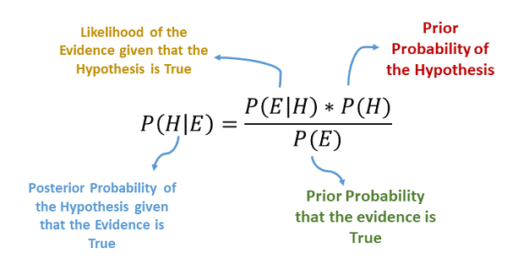
Naive Bayes’s
Definition:
A probabilistic classification algorithm based on Bayes’ theorem.
Assumes features are independent given the class (Naive assumption).
Used in text classification, spam filtering, sentiment analysis, medical diagnosis, etc.

Slide 3
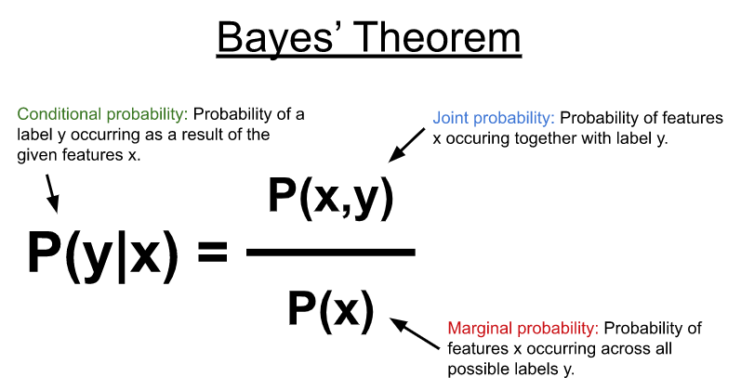

Bayes’ Theorem: The Foundation of Naive Bayes
Formula:
Where:
✅ P(A∣B) → Posterior Probability (What we want to find) ✅ P(B∣A) → Likelihood (Probability of evidence given the class) ✅ P(A) → Prior Probability (Class probability) ✅ P(B) → Evidence Probability (Normalization factor)

Slide 4
Example of Bayes’ Theorem in Action
Problem: Predict if a person has a disease given a positive test result.
Given:
P( Disease ) = 0.01
P( Positive ∣ Disease) = 0.9
P( Positive ∣ No Disease ) = 0.2
Compute P( Disease ∣ Positive ) using Bayes’ Theorem.

Slide 5
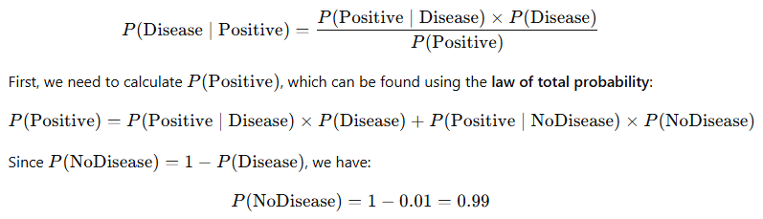
Example of Bayes’ Theorem in Action
We can compute 𝑃( Disease ∣ Positive ) using Bayes’ Theorem:

Slide 6
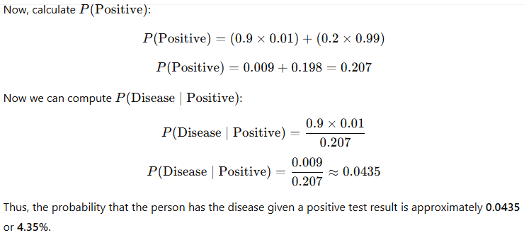
Example of Bayes’ Theorem in Action

Slide 7
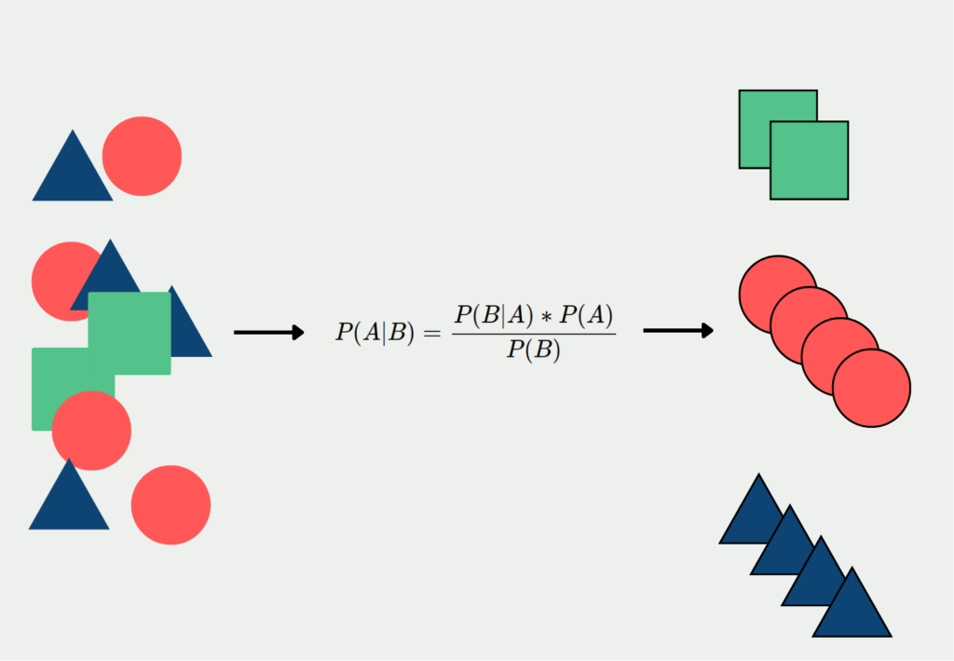
Naive Bayes Algorithm
Why “Naive” in Naive Bayes?
🎯 Naive Assumption:
Assumes all features are independent, which simplifies calculations.
Works well despite this assumption in many real-world cases.

Slide 8
Naive Bayes in Simple Terms
Example: Is It a "Rainy Day" or "Sunny Day" Based on Observations?
Imagine you are trying to predict the weather (Rainy 🌧 or Sunny ☀) based on three simple observations:
1️⃣ Sky (Cloudy or Clear)
2️⃣ Temperature (Cold or Hot)
3️⃣ Wind (Strong or Weak)

Slide 9
Naive Bayes in Simple Terms
Let’s say you have a small dataset from past days:
Sky | Temperature | Wind | Weather (Label)
Cloudy | Cold | Strong | Rainy 🌧
Clear | Hot | Weak | Sunny ☀
Cloudy | Hot | Strong | Rainy 🌧
Cloudy | Cold | Weak | Rainy 🌧
Clear | Cold | Weak | Sunny ☀
Clear | Hot | Strong | Sunny ☀
Now, suppose today's weather conditions are:
Sky = Cloudy
Temperature = Hot
Wind = Weak
We want to predict whether today is Rainy or Sunny using Naive Bayes.

Slide 10
Convert to Probability
We use past data to calculate probabilities.
Step 1.1: Prior Probability (How common are Rainy and Sunny days?)
From our dataset:
Rainy Days: 3 out of 6 → P(Rainy) = 3/6 = 0.5
Sunny Days: 3 out of 6 → P(Sunny) = 3/6 = 0.5
Step 1.2: Likelihood (How often do these features occur for each class?)
Looking at our dataset:
👉 For Rainy 🌧 Days:
P(Cloudy | Rainy) = 2/3
P(Hot | Rainy) = 1/3
P(Weak Wind | Rainy) = 1/3
👉 For Sunny ☀ Days:
P(Cloudy | Sunny) = 1/3
P(Hot | Sunny) = 2/3
P(Weak Wind | Sunny) = 2/3

Slide 11
Apply Bayes’ Theorem
To predict whether today is Rainy or Sunny, we compute:
Probability of Rainy
P(Rainy | Cloudy, Hot, Weak) = P(Cloudy | Rainy) × P(Hot | Rainy) × P(Weak | Rainy) × P(Rainy) = (2/3) × (1/3) × (1/3) × (0.5) = 0.037
Probability of Sunny
P(Sunny | Cloudy, Hot, Weak) = P(Cloudy | Sunny) × P(Hot | Sunny) × P(Weak | Sunny) × P(Sunny) = (1/3) × (2/3) × (2/3) × (0.5) = 0.074

Slide 12
Choose the Higher Probability
P(Rainy) = 0.037
P(Sunny) = 0.074
Since 0.074 > 0.037, our model predicts today is Sunny ☀!

Slide 13
Types of Naive Bayes Classifiers
Gaussian Naive Bayes
Multinomial Naive Bayes
Bernoulli Naive Bayes

Slide 14
Advantages and Disadvantages
Advantages of Naive Bayes
✅ Fast & Efficient: Works well on large datasets ✅ Handles Missing Data: Not affected by missing values ✅ Performs Well for Text Classification
Limitations of Naive Bayes
❌ Feature Independence Assumption is Unrealistic ❌ Not Suitable for Complex Relationships Between Features

Slide 15
Applications of Naive Bayes
Real-World Applications of Naive Bayes
✅ Spam Filtering (Email Classification) ✅ Sentiment Analysis (Positive vs. Negative reviews) ✅ Medical Diagnosis (Disease Prediction) ✅ Text Classification (News categorization)

Slide 16
Thank You

